Slide 1

Green Pace
Security Policy Presentation
Developer: Mohamed Elmarzougui
Project Two: Security Policy Presentation

Slide 2

OVERVIEW: DEFENSE IN DEPTH
The Green Pace Security Policy ensures all developers follow the same secure coding and system practices. As the team grows, this policy keeps everyone aligned. It supports a defense-in-depth strategy by using multiple security layers—like coding standards, encryption, testing, and access control—to reduce risk and protect against attacks.

Slide 3
THREATS MATRIX
The threats are arranged in order of likelihood and priority. How likely a threat is should determine how often it’s monitored and whether detection can be automated. High-priority threats need to be addressed as soon as possible because they pose the greatest risk to security and product stability. By focusing on the most common and damaging issues first, we can reduce vulnerabilities and strengthen our overall security posture.
Likely STD-003-CPP STD-004-CPP STD-009-CPP | Priority STD-005-CPP
Low priority STD-002-CPP STD-008-CPP STD-005-CPP | Unlikely STD-001-CPP STD-006-CPP STD-007-CPP

Slide 4
10 PRINCIPLES
Validate input data
Heed compiler warnings
Architect and design for security policies
Keep it simple
Default deny
Adhere to the principle of least privilege
Sanitize data sent to other systems
Practice defense in depth
use effective quality assurance techniques
Adopt a secure coding standard

Slide 5
CODING STANDARDS
Data Type: Prevents type confusion, overflows, and logic errors
Data Value: Ensures inputs are within expected, safe ranges
String Correctness: Prevents buffer overflows and injection attacks
Memory Protection: Avoids leaks, overflows, and unauthorized access
SQL Injection: Blocks dangerous queries and preserves database integrity
Exceptions: Prevents system crashes and exposure of sensitive info
Function return value: Ensures safe and expected behavior after function calls
Assertions: Catches logic errors during development
Commenting: Makes code understandable and maintainable
Qualifying refence types: Prevents misinterpretation of object types and unsafe access

Slide 6
ENCRYPTION POLICIES
Encryption in Rest:
Protects data stored on disk, ensuring its security even if hardware is accessed by unauthorized parties or attackers gain physical access to the system.
Encryption in Transit:
Secures data as it moves between client and server, preventing interception by attackers through encryption protocols.
Encryption in Use:
Ensures data remains protected throughout its lifecycle, even while being processed, safeguarding against breaches and reducing risks.

Slide 7
TRIPLE-A POLICIES
Authentication
Require strong, unique credentials for all users.
Use multi-factor authentication (MFA) to verify identity.
Authorization
Grant users the minimum level of access necessary (least privilege).
Regularly review and update user permissions.
Accounting
Monitor logs for unusual or unauthorized behavior.
Use automated tools for audit trails and reporting.

Slide 8
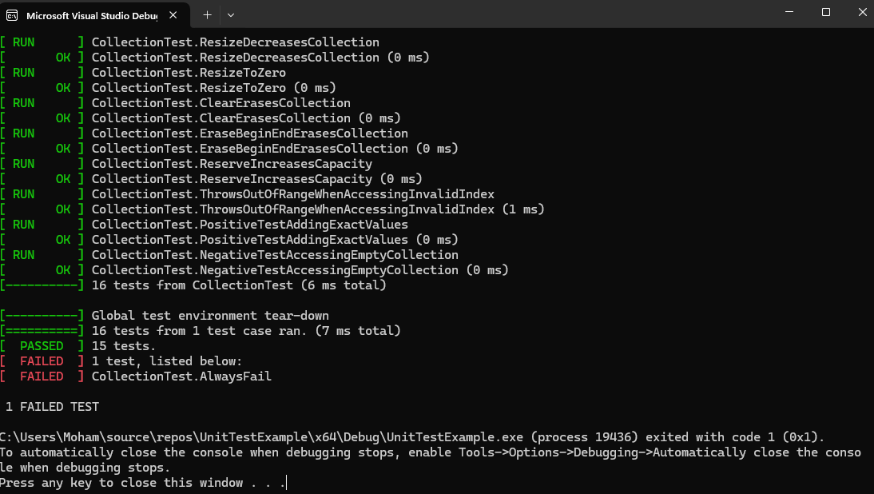
Unit Testing
Unit testing helps prevent and limit issues in our code by checking each part for errors and vulnerabilities. It ensures that inputs are handled safely, memory is managed properly, and functions behave as expected. This keeps bugs and security flaws from spreading into the larger system.

Slide 9

AUTOMATION SUMMARY

Slide 10
TOOLS
The DevSecOps pipeline integrates security at every stage of development, from coding through deployment. It ensures that security is considered throughout the lifecycle, with tools like static analysis to identify vulnerabilities early, and automated tests that catch bugs during build and integration. This process minimizes security risks by addressing potential issues proactively, not just at the end of the development cycle.
In the DevSecOps pipeline, various external tools are used at different stages to ensure security. For example, Astrée, a static code analyzer, is used during the coding phase to identify potential errors and vulnerabilities before runtime. During the build and integration stages, other automated tools run to ensure code quality and security. OWASP ZAP is utilized for dynamic application security testing (DAST) to identify issues during runtime. Additionally, tools like Jenkins or GitLab CI automate the build, test, and deployment processes, integrating security checks at each step.

Slide 11
RISKS AND BENEFITS
Pros:
Early and continuous security integration reduces vulnerabilities before exploitation.
Improves code quality and system integrity by embedding security into the development process.
Provides proactive protection, minimizing the risk of breaches.
Cons:
Upfront costs for tools, training, and integration.
Time commitment required for team adaptation and workflow adjustments.

Slide 12
RECOMMENDATIONS
Integrate security early and throughout the development lifecycle.
Automate security testing where possible to reduce risk and human error.
Standardized code improves readability, consistency, and maintainability.
Provide ongoing secure coding training for developers.
Create a feedback loop to update policies based on real incidents and audits.
Policies must evolve to defend against emerging threats.
This guide is a starting point—more standards will be added as needed.

Slide 13
CONCLUSIONS
Security is an ongoing process that must evolve with emerging threats.
Adopting standards like OWASP and NIST strengthens the foundation.
Secure coding and defense-in-depth reduce vulnerabilities early in development.
DevSecOps builds security into every phase, improving response time and resilience.
Continuous monitoring and regular policy updates help prevent future problems.
A proactive approach leads to safer applications and stronger user trust.

Slide 14
REFERENCES
National Institute of Standards and Technology. (2020). Framework for improving critical infrastructure cybersecurity (Version 1.1). https://www.nist.gov/cyberframework
OWASP Foundation. (n.d.). OWASP Top Ten. https://owasp.org/www-project-top-ten/
Microsoft. (2023). DevSecOps guidance. https://learn.microsoft.com/en-us/devops/deliver/devsecops

